Slide 1
CENTRE for INDUSTRY
EDUCATION COLLABORATION
Sustainable ingredients:
A bit of a stretch

Slide 2
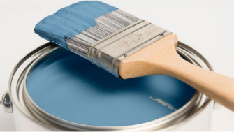
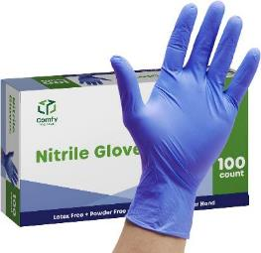
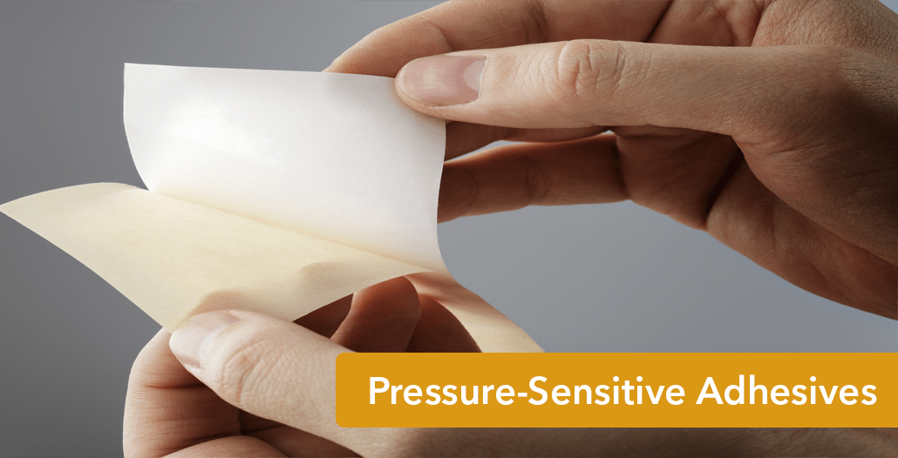
Important ingredients made by companies like Synthomer are used to make lots of different products.
Range of images showing products made using Synthomer ingredients.
glue
paints
protective gloves
Notes:
Images: provided by Synthomer - JPGs requested

Slide 3
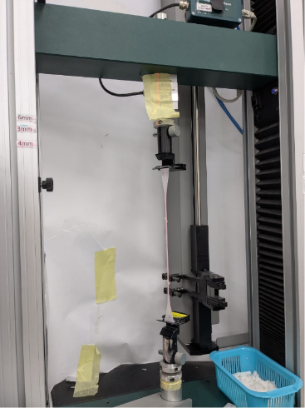
Synthomer scientists carry out tests to make sure their important ingredients work the way they want them too.
Notes:
Images: provided by Synthomer - JPG and video requested

Slide 4
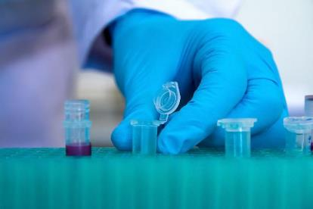
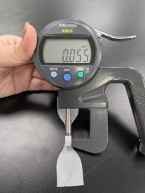
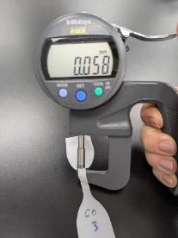
The important ingredients are used to make protective gloves.
These gloves are thinner, last longer, and use less heat to make.
protective gloves used in a lab
measuring glove thickness
The process of making the gloves is better for the environment.

Slide 5
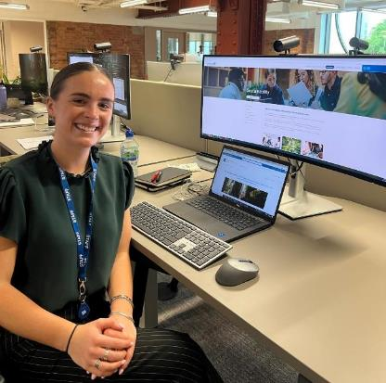
STEM Careers
This is Orlagh. Her job at Synthomer is all about sustainability.
She checks how Synthomer treats the Earth, how it treats people, and if it follows good rules. She helps people decide if the company is doing the right thing, not selling products.
Orlagh uses her computer to make charts and look at big reports to track how the company is doing and compares it to other big companies.
Notes:
Image: JPG provided by Synthomer
Note for AT - Awaiting confirmation of Orlagh’s job title.

Slide 6
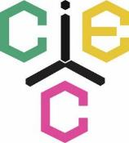
www.ciec.org.uk

